Slide 1
Inventory Kimball & Ross, Chapter 3

Slide 2
Overview
Value chain implications
Inventory periodic snapshot model, transaction and accumulating snapshot models
Semi-additive facts
Enhanced inventory facts
Data Warehouse bus architecture and matrix
Conformed dimensions and facts

Slide 3
Value Chain
The value chain identifies the natural, logical flow of an organization’s primary activities. See Fig. 3.1
Operational source systems produce transactions or snapshots at each step in the value chain. They generate interesting performance metrics along the way.
Each business process generates one or more fact tables.

Slide 4
A family of stars
A dimensional model of a data warehouse for a large data warehouse consists of between 10 and 25 similar-looking star-join schemas. Each star join will have 5 to 15 dimensional tables.
Conformed (shared) dimensions facilitate drillacross.
A conformed dimension is a dimension that means the same thing with every possible fact table to which it is joined.
Conformed dimensions are either identical or strict mathematical subsets of the most granular detailed dimension.

Slide 5
Value chains as families of star-join schemas
There are two sides to the value chain
– the demand side - the steps needed to satisfy the customers’ demand for the product
– the supply side - the steps needed to manufacture the products from original ingredients or parts
The chain consists of a sequence of inventory and flow star-join schema
joining the different star-join schema is only possible when two sequential schema have a common, identical dimension
Sometimes the represented chain can be extended beyond the bounds of the business itself

Slide 6
Value chains as families of star-join schemas
Supply Chain
• Row material production
• Ingredient purchasing
• Ingredient delivery
• Ingredient inventory
• Bill of materials
• Manufacturing process
control
• Manufacturing costs
• Packaging
• Trans-shipping to warehouse
• Finished goods inventory
Demand Chain
• Finished goods inventory
• Manufacturing shipments
• Distributor inventory
• Distributor shipments
• Retail inventory
• Retail sales

Slide 7
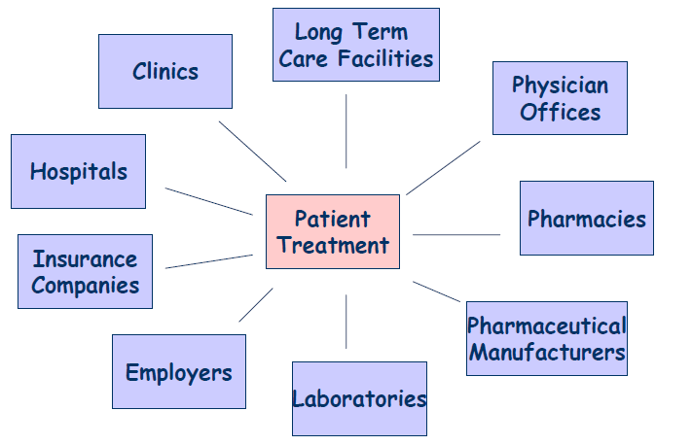
Value circles

Slide 8
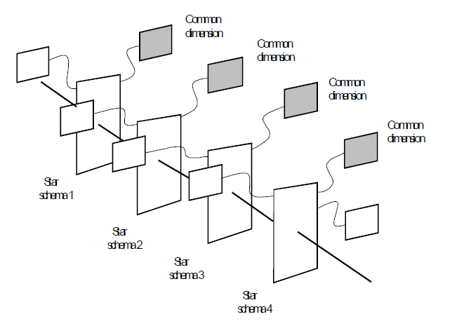
A family of stars

Slide 9
Inventory Models
Inventory periodic snapshot
Inventory level of each product measured daily (or weekly) – represented as a separate row in a fact table
Inventory transactions
As products move through the warehouse, all transactions with impact on inventory levels are recorded
Inventory accumulating snapshot
One fact table row for each product updated as the product moves through the warehouse

Slide 10
Inventory Periodic Snapshot Model
Business need
Analysis of daily quantity-on-hand inventory levels by product and store
Business process
Retail store inventory
Granularity
Daily inventory by product at each store
Dimensions
Date, product, store
Fact
Quantity on hand

Slide 11
Inventory Periodic Snapshot Model - Challenge
Very dense (huge) fact table
As opposed to retail sales, which was sparse because only about 10% of products sell each day
60,000 items in 100 stores = 6,000,000 rows
If 14 bytes per row: 84MB per day
One-year period: 365 x 84MB = 30GB
Solution: Reduce snapshot frequencies over time
Last 60 days at daily level
Weekly snapshots for historical data
For a 3-year period =208 snapshots vs. 3x365=1095 snapshots; reduction by a factor of 5

Slide 12
Semiadditive Facts
Inventory levels (quantity on hand) are additive across products or stores, but NOT across dates = semi-additive facts
Compare to Retail Sales:
once the product is sold it is not counted again
Static level measurements (inventory, balances…) are not additive across date dimension; to aggregate over time use average over number of time periods.

Slide 13
Enhanced Inventory Facts
Number of turns = total quantity sold / daily average quantity on hand
Days’ supply = final quantity on hand / average quantity sold
Gross profit = value at latest selling price - value at cost
Gross margin = gross profit / value at latest selling price
GMROI (Gross Margin Return On Inventory)
GMROI = number of turns * gross margin
measures effectiveness of inventory investment
high = lot of turns and more profit, low = low turns and low profit
Need additional facts:
quantity sold, value at cost, value at latest selling price
GMROI is not additive and, therefore, is not stored in enhanced fact table. It is calculated from the constituent columns.

Slide 14
Inventory Transactions Model
Record every transaction that affects inventory
Receive product
Place product into inspection hold
Release product from inspection hold
Return product to vendor due to inspection failure
Place product in bin
Authorize product for sale
Pick product from bin
Package product for shipment
Ship product to customer
Receive product from customer
Return product to inventory from customer return
Remove product from inventory

Slide 15
Inventory Transactions Model - Con’t
Dimensions: date, warehouse, product, vendor, inventory transaction type.
The transaction-level fact table contains the most detailed information possible about the inventory.
It is useful for measuring the frequency and timing of specific transaction types.
It is impractical for broad data warehouse questions that span dates or products.
To give a more cumulative view of a process, some form of snapshot table often accompanies a transaction fact table.

Slide 16
Inventory Accumulating Snapshot Model
Build one record in the fact table for each product delivery to the warehouse
Track disposition of a product until it leaves the warehouse
Receiving
Inspection
Bin placement
Authorization to sell
Picking
Boxing
Shipping
The philosophy of the inventory accumulating snapshot fact table is to provide an updated status of the product shipment as it moves through above milestones.
Rarely used in long-running, continuously replenished inventory processes.
More on this in chapter 5.

Slide 17
Value Chain Integration
Both business and IT organizations are interested in value chain integration
Desire to look across the business to better evaluate overall performance
Data marts may correspond to different business processes
Need to look consistently at dimensions shared between business processes
Need an integrated data warehouse architecture
If dimension table attributes in various marts are identical, each mart is queried separately; the results are then outer-joined based on a common dimension attribute = drill across

Slide 18
Data Warehouse Bus Architecture
Cannot built the enterprise data warehouse in one step.
Building isolated pieces will defeat consistency goal.
Need an architected incremental approach → data warehouse bus architecture.
See Fig. 3.7
By defining a standard bus interface for the data warehouse environment, separate data marts can be implemented by different groups at different times. The separate data marts can be plugged together and usefully coexist if they adhere to the standard.

Slide 19
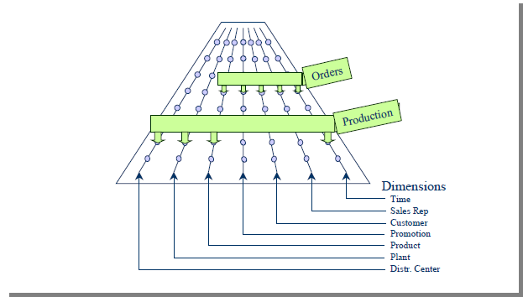
The Data Warehouse Bus

Slide 20
Data Warehouse Bus Architecture – Cont’d
During architecture phase, team designs a master suite of standardized dimensions and facts that have uniform interpretation across the enterprise.
Separate data marts are then developed adhering to this architecture.

Slide 21
Data Warehouse Bus Matrix
See Figure 3.8
The rows of the bus matrix correspond to business processes → data marts
Separate rows should be created if:
the sources are different,
the processes are different, or
a row represents more than what can be tackled in a single implementation iteration.
Creating the DW bus matrix is a very important up-front deliverable of a DW implementation. The DW bus matrix is a hybrid resource: technical design tool, project management tool, and communication tool.

Slide 22
Enterprise Bus Architecture
Requirements are gathered and represented in a form of Enterprise Data Warehouse Bus Matrix
Each row corresponds to a business/process
Each column corresponds to a dimension of the business
Each column is a conformed dimension
Enterprise Data Warehouse Bus Matrix documents the overall data architecture for DW/BI system

Slide 23
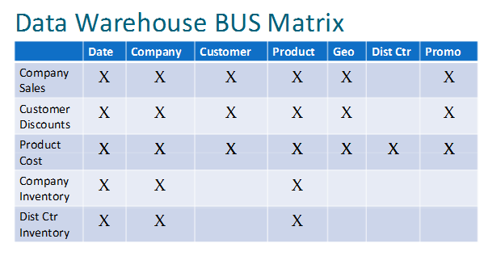
DW Bus Matrix

Slide 24
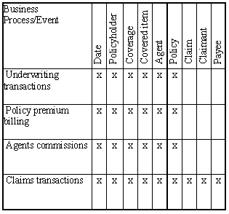
Enterprise Bus Architecture Matrix

Slide 25
Enterprise Bus Architecture Matrix
Possible Problems:
Level of details for each column and row in the matrix
Row-related
Listing departments/imitating organizational chart instead of business processes
Listing reports and analytics related to business process instead of the business process itself
Ex. Shipping orders business process supports various analytics such as customer ranking, sales rep performance, product movement analyses

Slide 26
Enterprise Bus Architecture Matrix
Possible Problems (Cont):
Column-related
Generalized columns/dimensions
Example: “Entity” column is too general as it includes employees, suppliers, contractors, vendors, customers
Too many columns related to the same dimension
Worst case when each attribute is listed separately
Example: Product, Product Group, LOB are all related to the Product dimension and should be listed as one.

Slide 27
Conformed Dimensions
Conformed dimensions are:
identical, or
strict mathematical subsets of the most granular, detailed dimension.
Conformed dimensions have consistent
Dimension keys
Attribute column names
Attribute definitions
Attribute values
If two marts have dimensions (e.g., customer, product) that are not conformed, then they cannot be used together

Slide 28
Conformed Dimensions
master or common reference dimensions
Shared across the DW environment joining to multiple fact tables representing various business processes
2 types
Identical dimensions
One dimension being a subset of a more detailed dimension

Slide 29
Conformed Dimensions
Identical dimensions
Same content, interpretation, and presentation regardless of the business process involved
Same keys, attribute names, attribute definitions, and domain values regardless of domain values they join to
Example: product dimension referenced by orders and the one referenced by inventory are identical
One dimension being a perfect subset of a more detailed, granular dimension table
Same attribute names, definitions, and domain values
Example: sales is linked to a dimension table at the individual product level; sales forecast is linked at the brand level

Slide 30
Conformed Dimensions
Product Dimension
Product key PK
Product description
SKU number
Brand description
Sub class description
Class description
Department description
Color
size
Display type
Sales Fact Table
Date key FK
Product key FK
… other FKeys…
Sales quantity
Sales amount
Sales Forecast Fact Table
Month key FK
Brand key FK
… other FKeys…
Forecast quantity
Forecast amount
Brand Dimension
Brand key PK
Brand description
Sub class description
Class description
Department description
Display type

Slide 31
Conformed Dimensions
Benefits
Consistency
Every fact table is filtered consistently and results are labeled consistently
Integration
Users can create queries that drill across fact tables representing different processes individually and then join result set on common dimension attributes
Reduced development time to market
Once created, conform dimensions are reused

Slide 32
Types of Dimension Conformity
Mean same thing
Single shared table or physical copy
Consistent data content, data interpretation, user presentation
Rolled-up level of granularity
Roll-up dimensions conform to the base-level atomic dimension if they are a strict subset of that atomic dimension. (see Fig. 3.9)
Dimension subset at same level of granularity
At same level but one represents only a subset of rows (see Fig. 3.10)
Combination of above

Slide 33
Centralized Dimension Authority
The major responsibility of the centralized dimension authority is to:
establish,
maintain, and
publish the conformed dimensions to all client data marts.
90% of up-front data architecture effort
Political challenge

Slide 34
Conformed Facts
In general, facts table data is not duplicated explicitly in multiple data marts.
If facts live in more than one location, then their definitions and equations must be the same and they must be called the same.
If it is impossible to conform a fact exactly, then different names should be given to different interpretations. This will make it less likely that incompatible facts will not be used in a calculation.

Slide 35
Rapidly Changing Dimensions
From the previous slides: What is slow?
What if the changes are fast?
Must a different design technique be used?
• Small dimensions:
– the same technologies as for slowly changing dimensions may be applied
• Large dimensions:
– the choice of indexing techniques and data design approaches are important
– find suppress duplicate entries in the dimension
– do not create additional records to handle the slowly changing dimension problem

Slide 36
Rapidly changing very large dimensions
• Break off some of the attributes into their own separate dimension(s), a demographic dimension(s).
– force the attributes selected to the demographic dimension to have relatively small number of discrete values
– build up the demographic dimension with all possible discrete attributes combinations
– construct a surrogate demographic key for this dimension
NB! The demographic attributes are the one of the
heavily used attributes. Their values are often
compared in order to identify interesting subsets.

Slide 37
More Rapidly Changing Dimensions
Break off the rapidly changing attributes into one or more separate dimensions
Two foreign keys in fact table:
Primary dimension table
Rapidly changing attribute(s)

Slide 38
Rapidly Changing Monster Dimensions
Multi-million customer dimension present unique challenges that warrant special treatment:
Browsing or constraining takes too long
Type-II change not feasible
Business users want to track the myriad of customer attribute changes, eg, insurance companies want accurate information of customers at the time of approval of a policy or when a claim is made

Slide 39
Mini-Dimensions
Single technique to handle browsing-performance & change tracking problems
Separate out frequently analyzed or frequently changing attributes into a separate dimension, called mini-dimension

Slide 40
Mini-Dimensions
Demographic Key | AGE | GENDER | INCOME LEVEL
1 | 20-24 | M | < 20000
2 | 20-24 | M | 20K-24999
3 | 20-24 | M | 25K-29999
18 | 25-29 | M | 20K-24999
10 | 25-29 | M | 25K-29999

Slide 41
Mini-Dimensions
Minidimension can not be itself allowed to grow very large
5 demographic attibutes
Each attribute can take 10 distinct values
How many rows in minidimension?
10,0000

Slide 42
Mini-Dimensions
Separate out a package of demographic attributes into a demographic mini-dimension
Age, gender, marital status, no. of children, income level, etc.
One row in mini-dimension for each unique combination of these attibutes

Slide 43
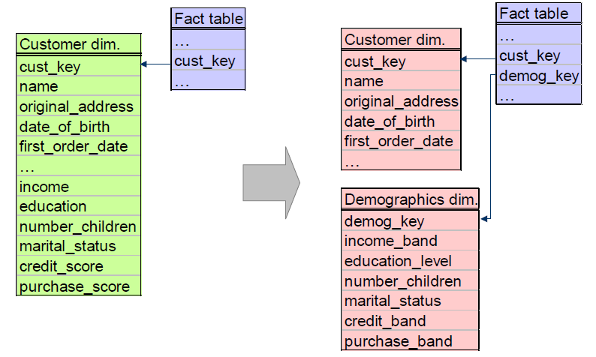
Demographic Minidimension

Slide 44
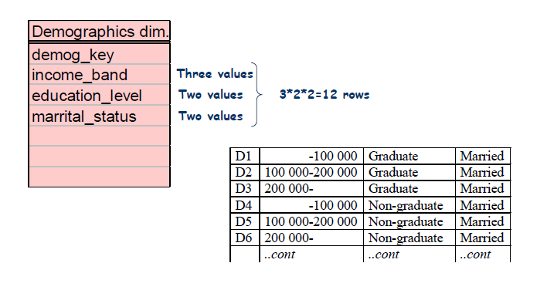
Demographic Minidimension

Slide 45
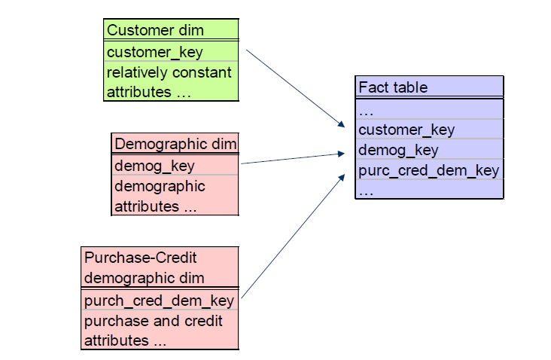
Two Demographic Minidimensions

Slide 46
Demographic Minidimension
• Advantages
– frequent ‘snapshoting’ of customers profiles with no increase in data storage or data complexity
• Drawbacks
– the demographic attributes are clumped into banded ranges of discrete values (it is impractical to change the set of value bands at a later time)
– the demographic dimension itself can not be allowed to grow too large
– slower down the browsing
• What if the fact table (connecting the demographic minidimension with the customer dimension) is sparse?

Slide 47
Demographic Minidimension
• What to do if the fact table (connecting the
demographic minidimension with the customer
dimension) is sparse?
– Define a demographic transaction event, i.e., introduce a new fact table
or
– Add a current demographic key to the customer dimension table

